Slide 2
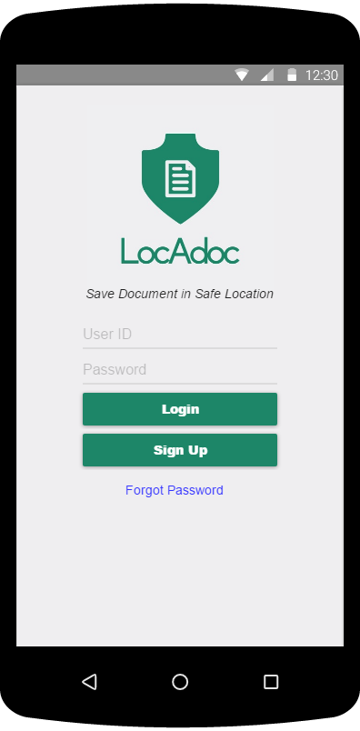
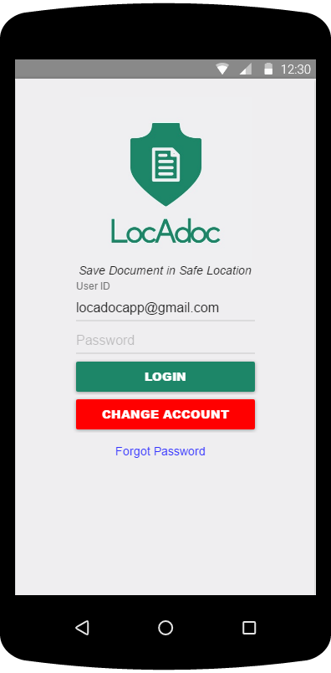
3
1
4
2
3
5
6
6
4
7
5
Notes:
Signup – Signup Form

Slide 3
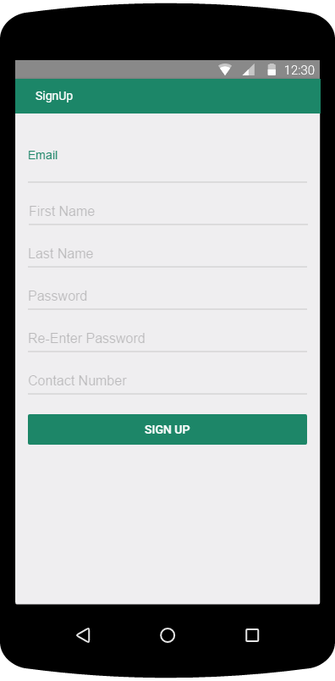
1
2
3
4
5
6
7
Notes:
Signup – Signup Form

Slide 4
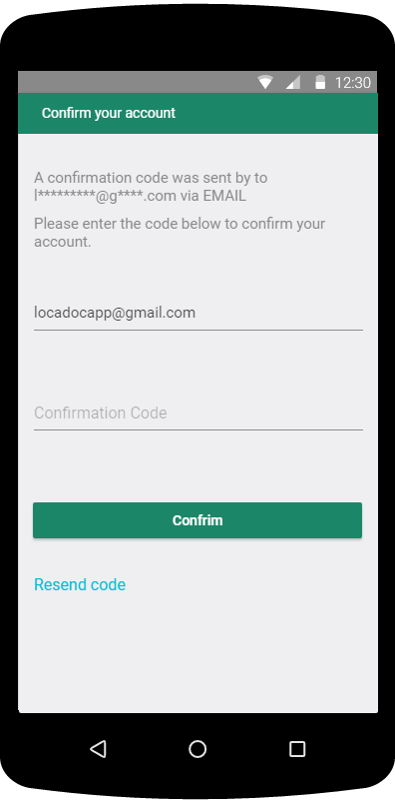
1
2
3
4
6
5
7
Notes:
Signup – Verification Step

Slide 5
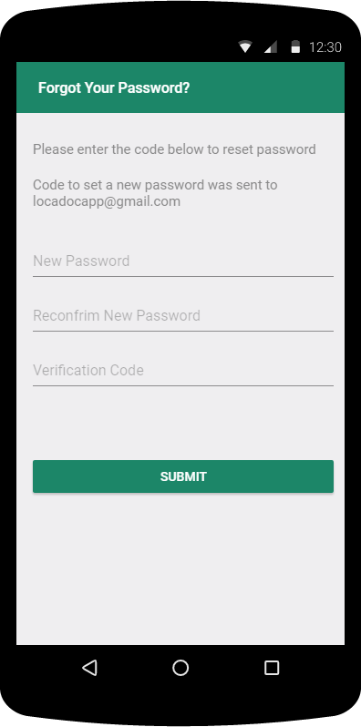
1
2
3
4
5
6
7
Notes:
Forgotpassword

Slide 6
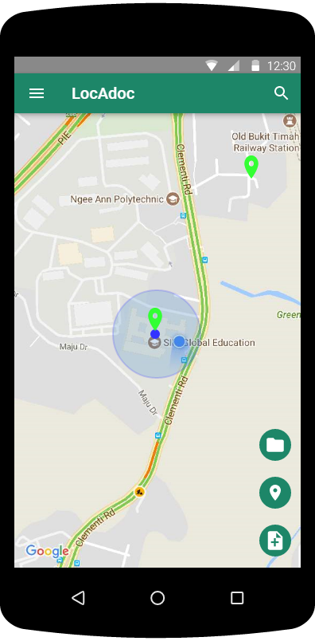
1
2
3
4
5
6
7
8
Notes:
HomePage

Slide 7
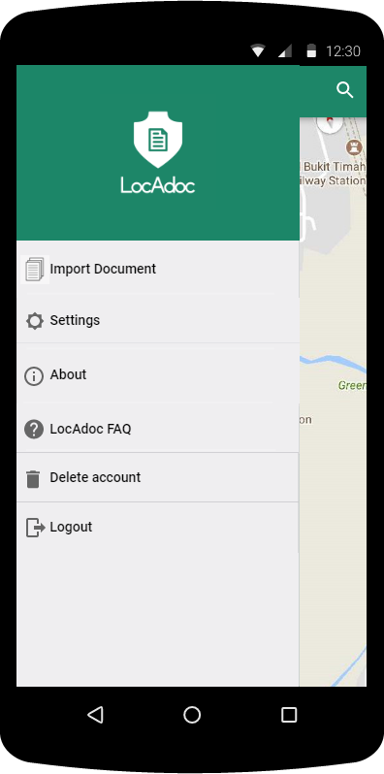
1
2
3
4
5
6
7
Notes:
Homepage_NaviMenu

Slide 8
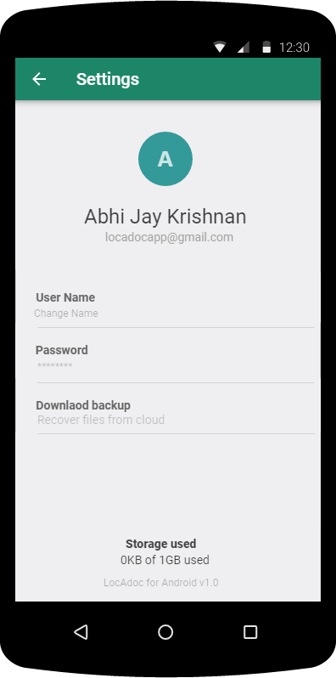
1
2
3
4
5
6
7
8
Notes:
Settings

Slide 9
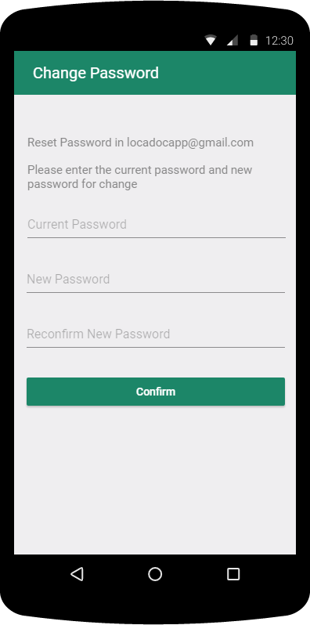
1
2
3
4
5
6
7
Notes:
Resetpassword

Slide 10
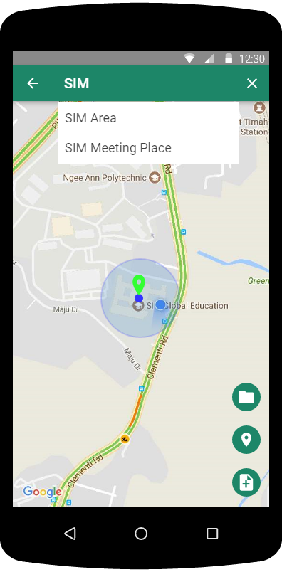
1
2
3
4
5
6
7
Notes:
HomeScreen (Searching Area)

Slide 11
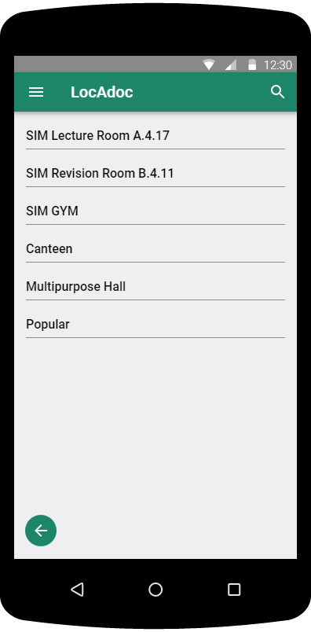
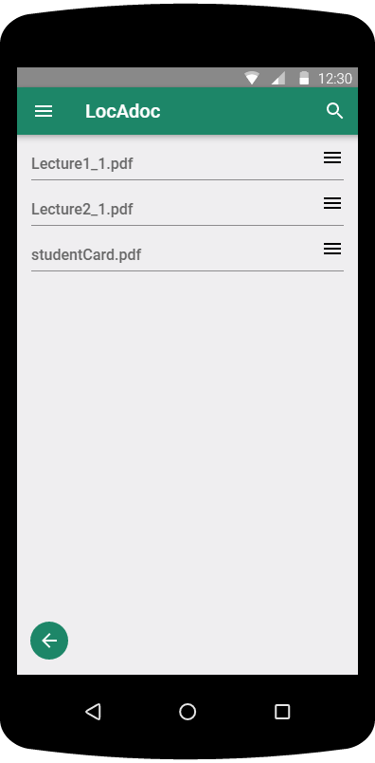
Select One Area
In Area List
Notes:
File Explorer:Area, File Explorer:File

Slide 12
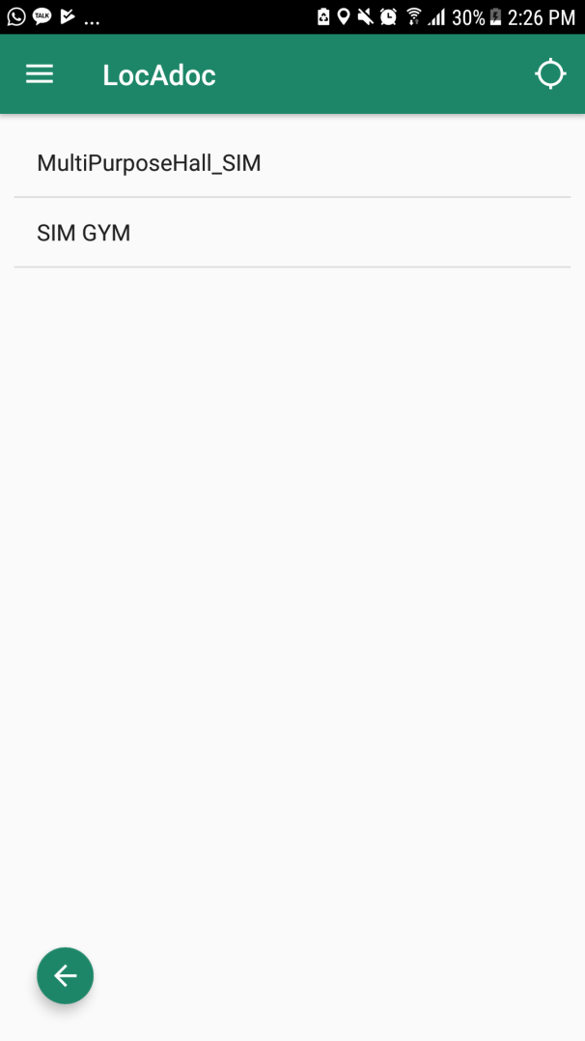
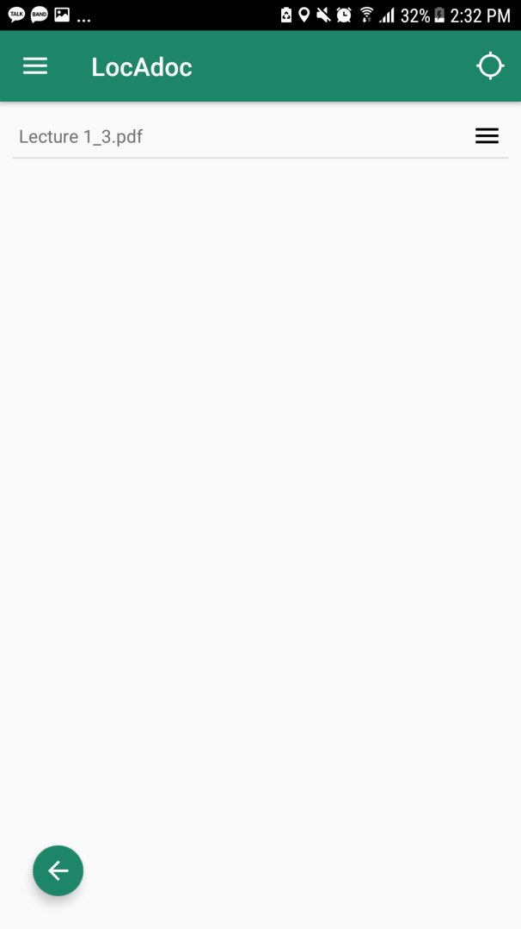
Select ‘SIM GYM’
In Area List
Notes:
File Explorer:Area, File Explorer:File

Slide 13
1
7
6
2
5
Select One Area
In Area List
3
4
7
Notes:
File Explorer:Area, File Explorer:File

Slide 14
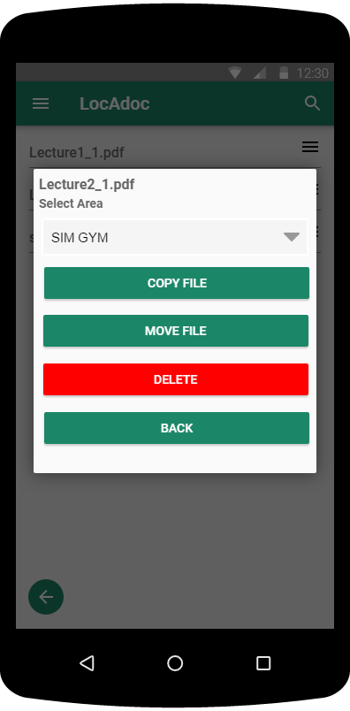
1
2
3
4
5
6
7
Notes:
Signup – Signup Form

Slide 15
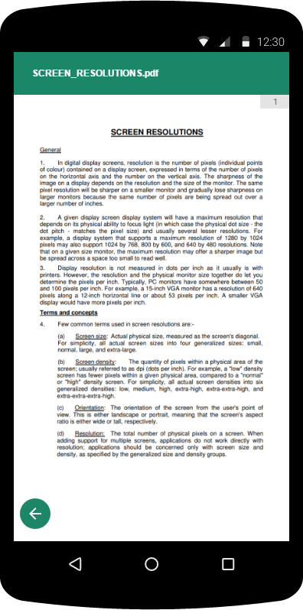
2
4
3
5
6
7
1
Notes:
PDFViewer

Slide 16
1
2
3
4
5
6
7
Notes:
Forgotpassword

Slide 17
1
2
3
4
5
6
7
Notes:
Forgotpassword

Slide 18
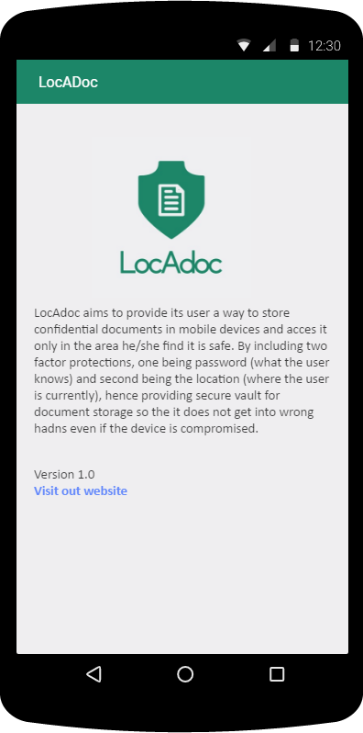
3
4
2
5
6
7
1
Notes:
AboutUs

Slide 19
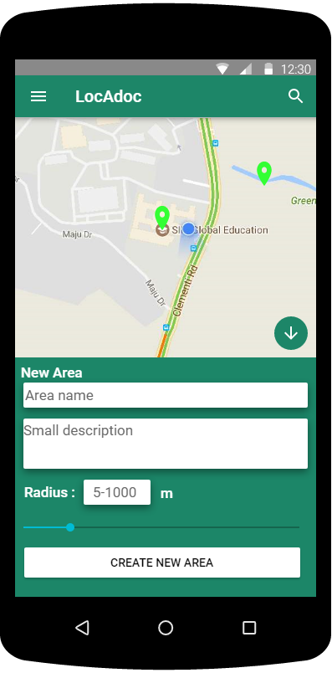
1
2
3
7
5
6
4
Notes:
Add Area

Slide 20
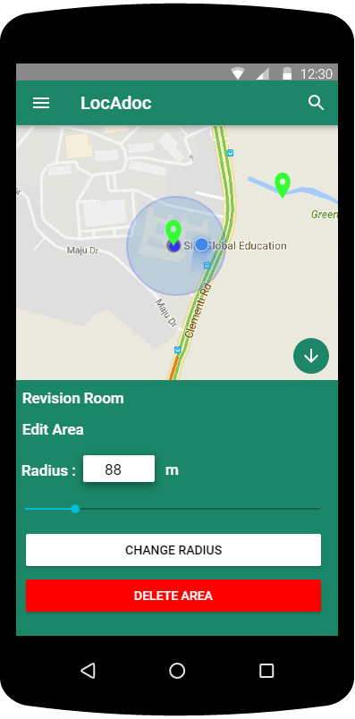
2
1
7
4
6
5
3
Notes:
AreaOperation

Slide 21
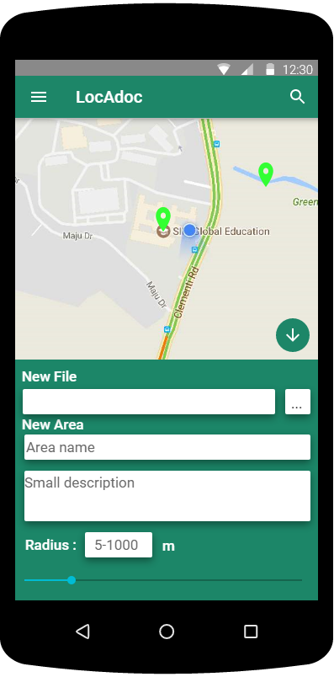
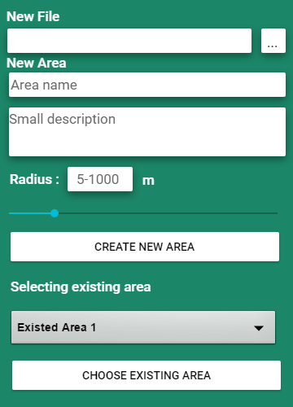
Notes:
Add Documents/Import Files

Slide 22
4
1
2
3
5
6
7
Notes:
Add File

Slide 23
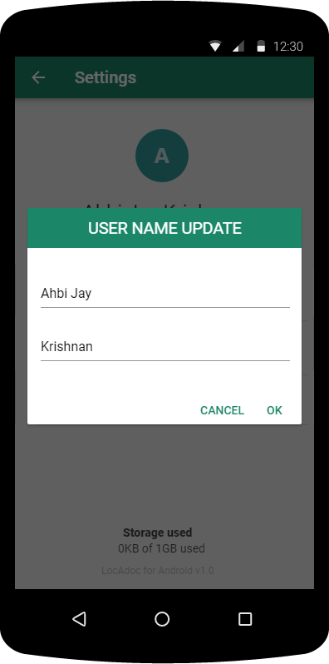
5
6
7
1
2
3
4
Notes:
Change Name

Slide 24
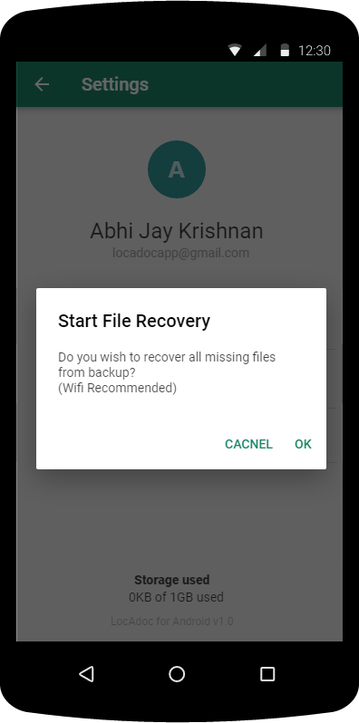
5
6
7
1
2
Notes:
Download Backup

Slide 25
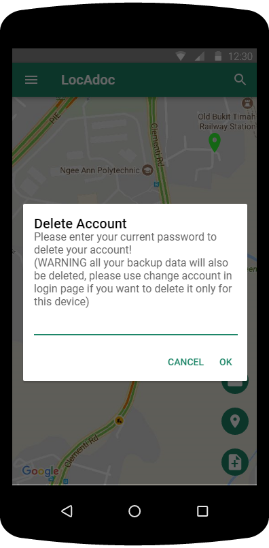
1
3
4
5
2
6
7
3
4
Notes:
Delete Account

